Slide 1
Continuation of Neena’s Research

Slide 2
Motivation
Examine where in the data collection steps is a better place for the accuracy of the integrative predictive models.
Neena’s claim
generally greater once the integration is performed in assignment step (multinets approach) rather than data collection step (single net approach)
Results were lackluster in my opinion. Needs more data

Slide 3
Methods
Ran the same tests that Neena did, except on a larger scale.
Attempt to run through as many diseases as possible

Slide 4
Results
Results of first few experiments run
Excluded: ones with nothing coming out of the pipeline

Slide 5
Acne Vulgaris
Of 3, chose 2: GDS2478, GDS3218

Slide 6
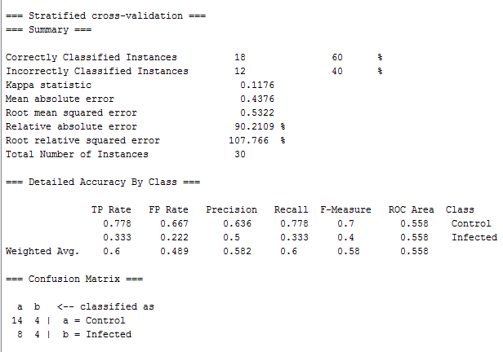
Acne Singlenet

Slide 7
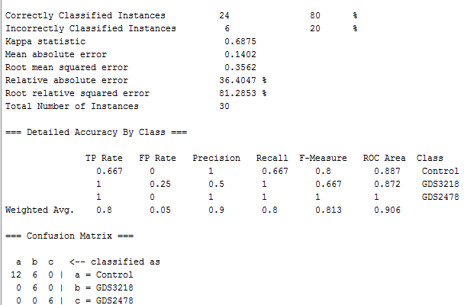
Acne Multinet

Slide 8
Alzheimer disease
Of 13, only chose the following: GDS2795, GDS2601, GDS1491, GDS811, GDS810, GDS809, GDS519, GDS1979

Slide 9
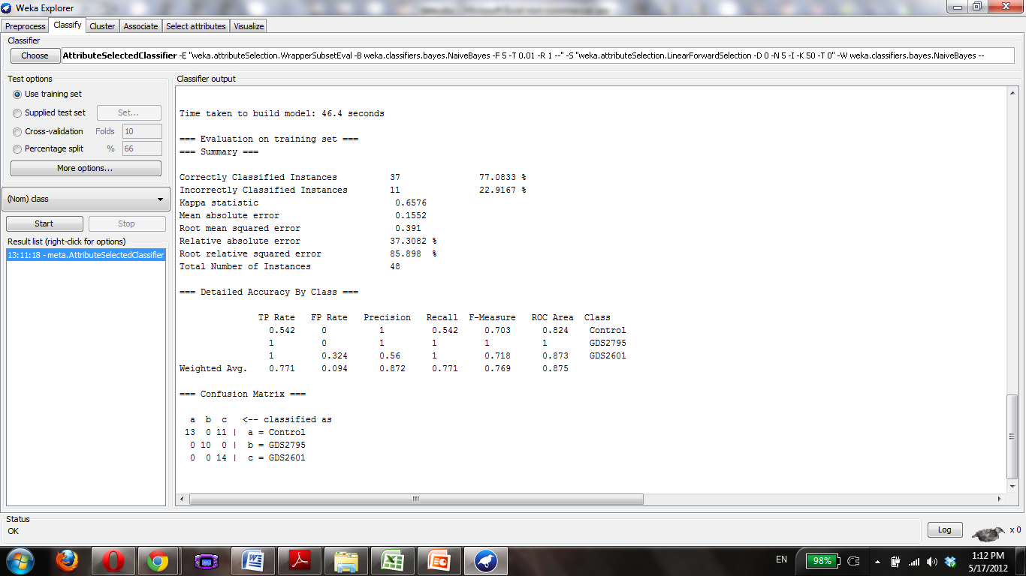

Slide 10
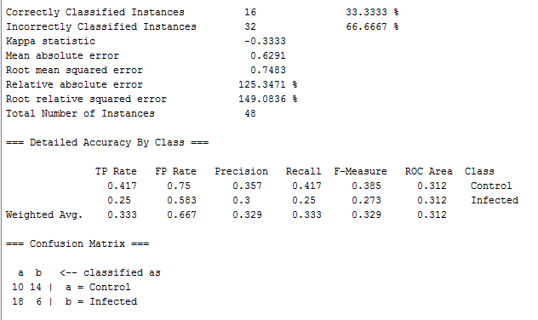
Alzheimer singlenet

Slide 11
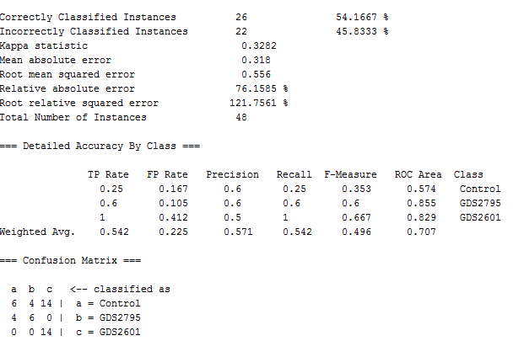
Alzheimer multinet

Slide 12
Anemia
Of 10: GDS3576, GDS3405, GDS3268, GDS2118, GDS2073, GDS1700, GDS1392

Slide 13
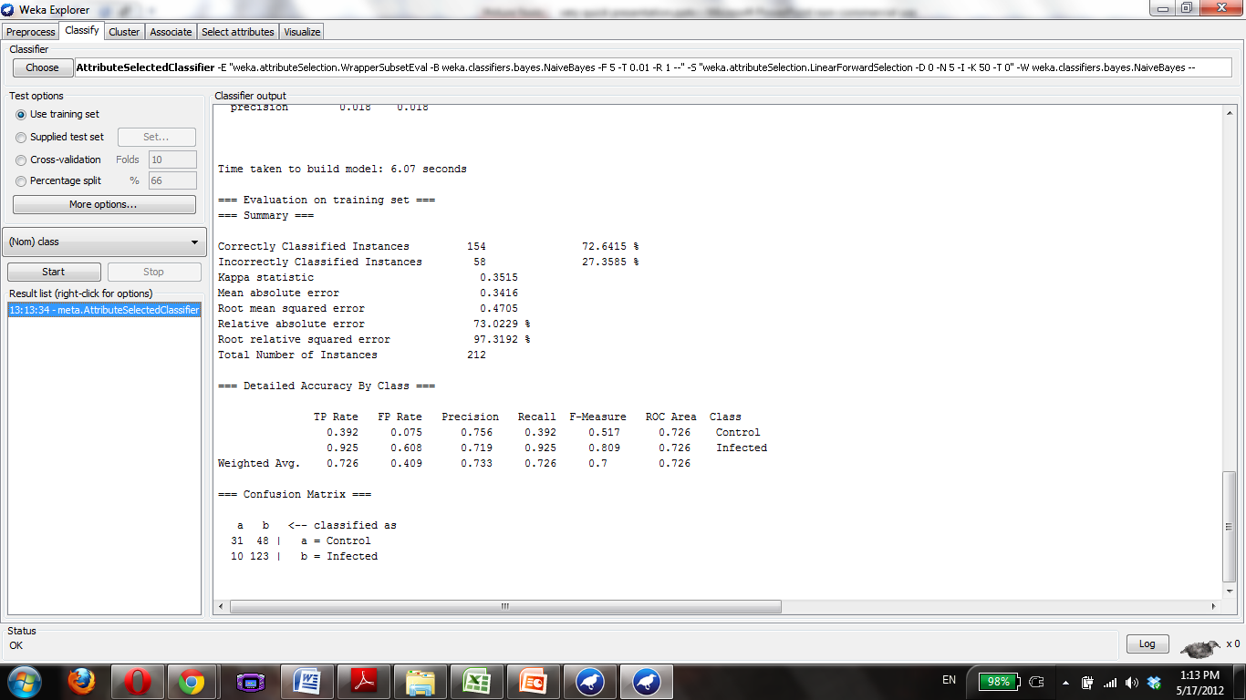

Slide 14
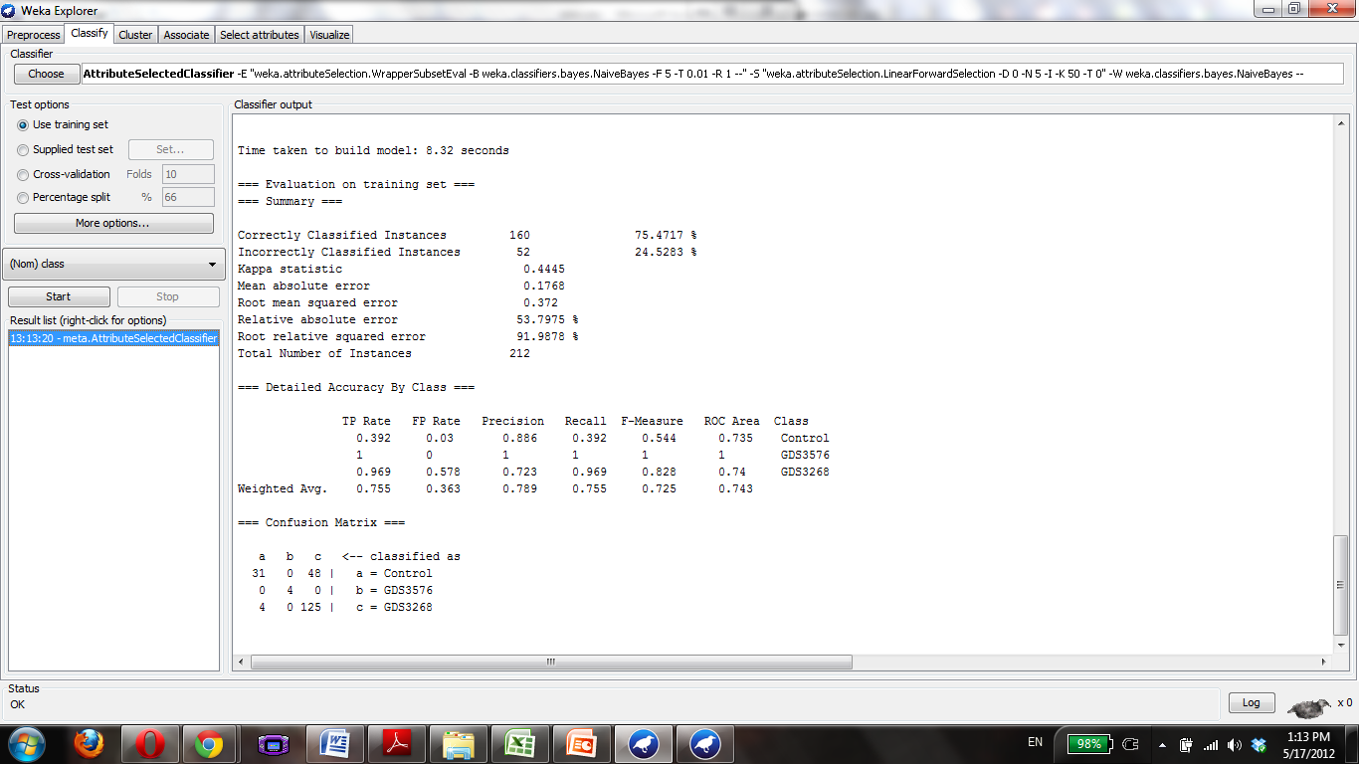

Slide 15
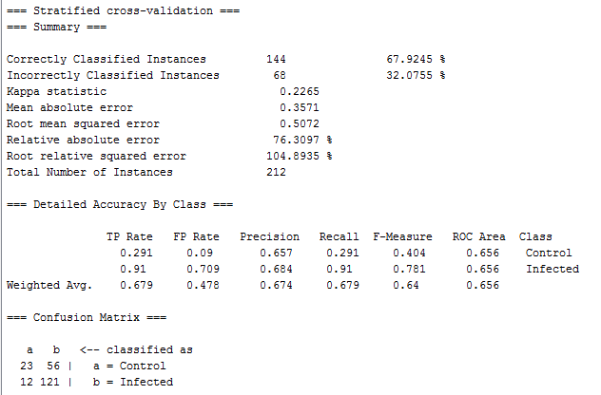
Anemia Singlenet

Slide 16
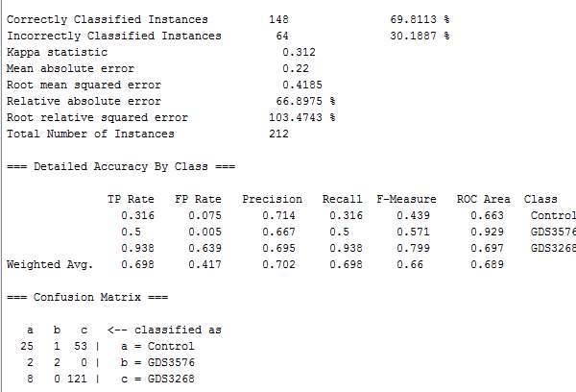
Anemia Multinet

Slide 17
Aortic Aneurysm
GDS2960, GDS2922, GDS2838

Slide 18
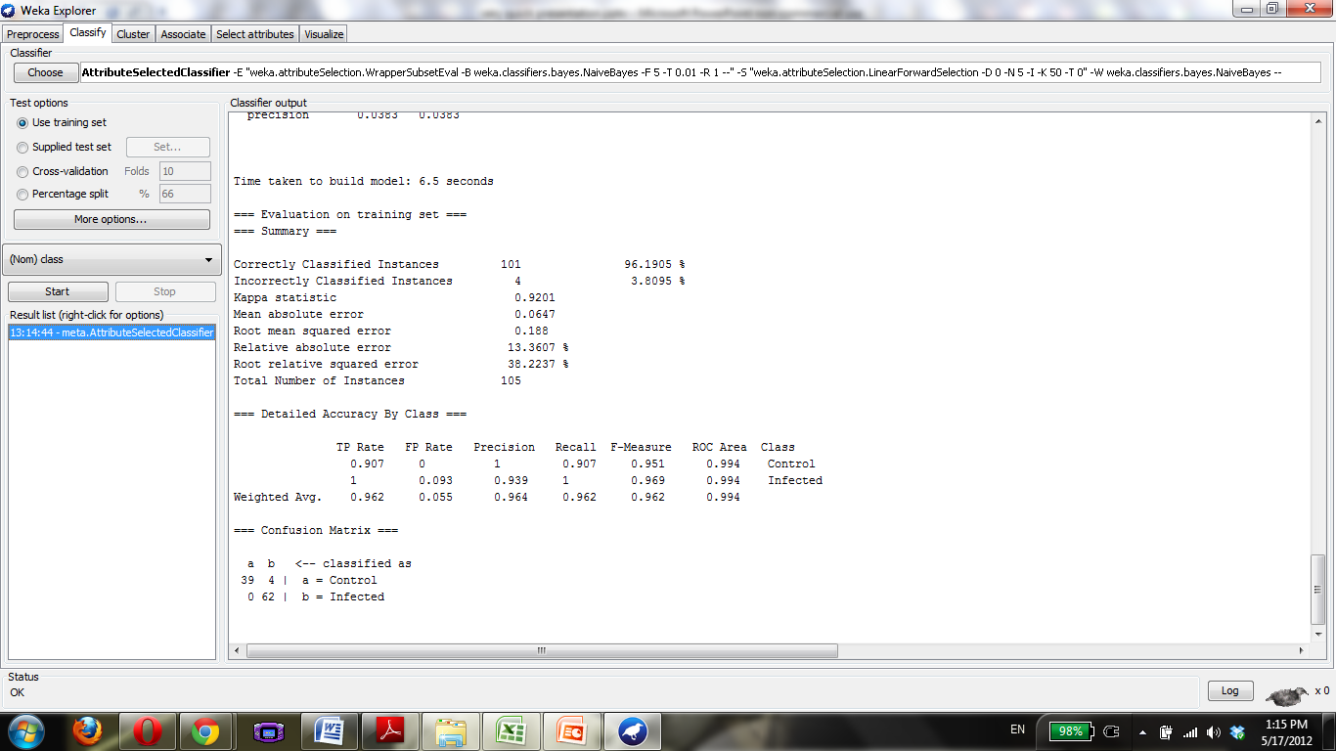

Slide 19


Slide 20
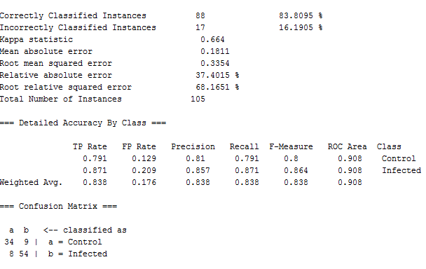
Aortic Aneurism Singlenet

Slide 21
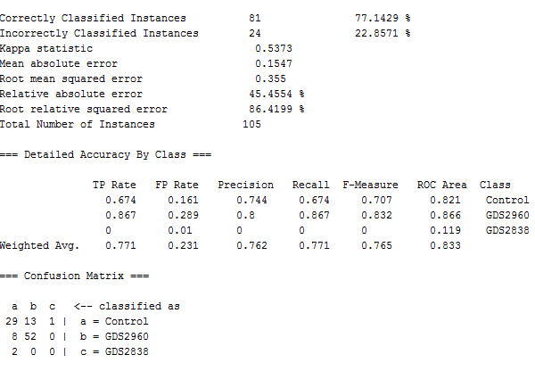
Aortic Aneurism Multinet

Slide 22
Rheumatoid Arthritis
GDS3628, GDS3203, GDS3192, GDS3158, GDS2952, GDS2931, GDS2885, GDS2126, GDS1857, GDS711

Slide 23
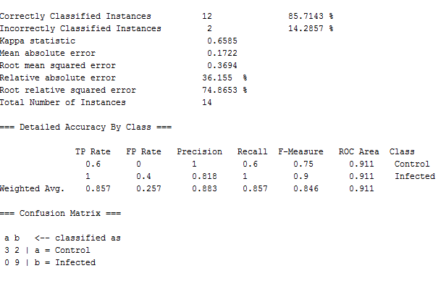
Rheumatoid Arthritis Singlenet

Slide 24
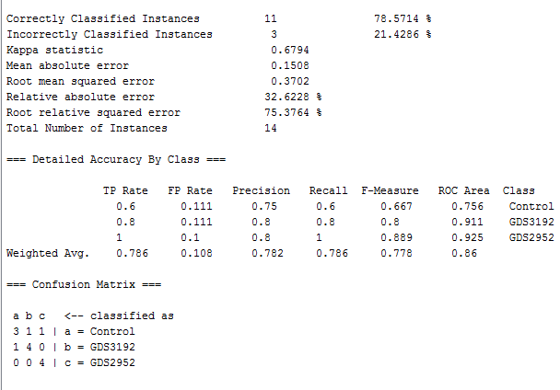
Rheumatoid Arthritis Multinet

Slide 25
Asthma
28 possible. Using:
GDS3711, GDS3615, GDS3573, GDS3268, GDS3073, GDS2976, GDS2852, GDS2628, GDS1985, GDS1520, GDS1269, GDS266, GDS261, GDS245, GDS240, GDS60

Slide 26


Slide 27
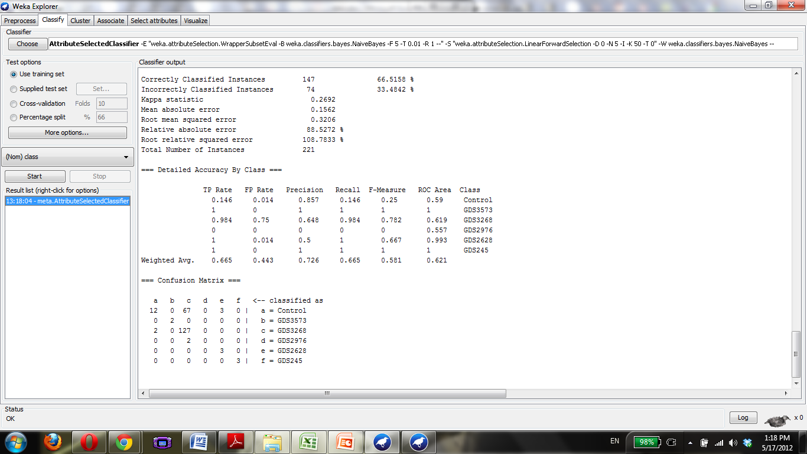

Slide 28
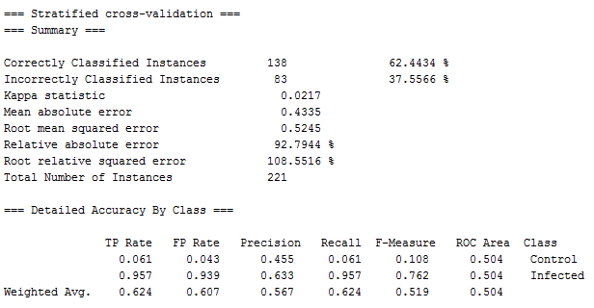
Asthma Singlenet

Slide 29
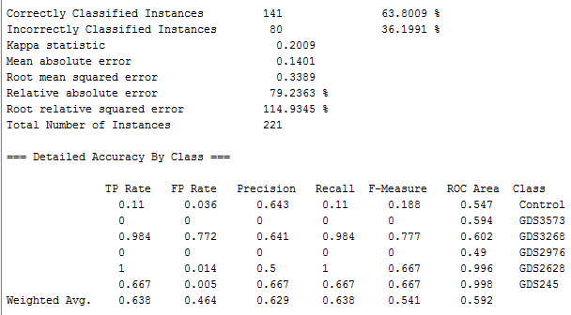
Asthma Multinet

Slide 30
Atherosclerosis
28 Available, choose
GDS2303, GDS2889, GDS3413, GDS3671, GDS3686, GDS3696, GDS3697, GDS3698, GDS3203

Slide 31
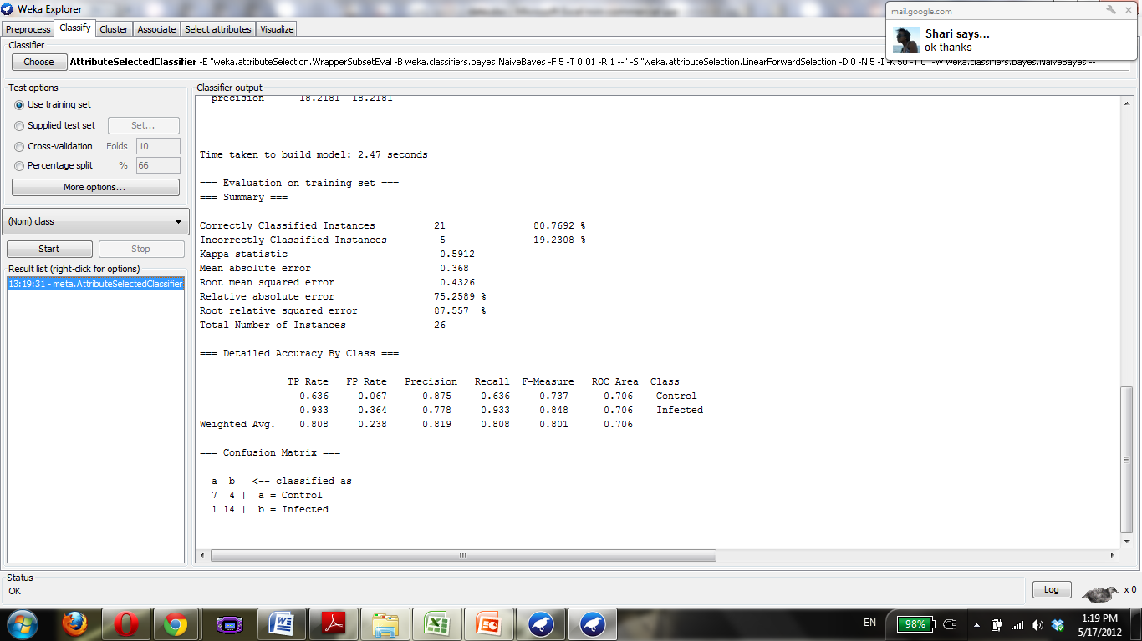

Slide 32
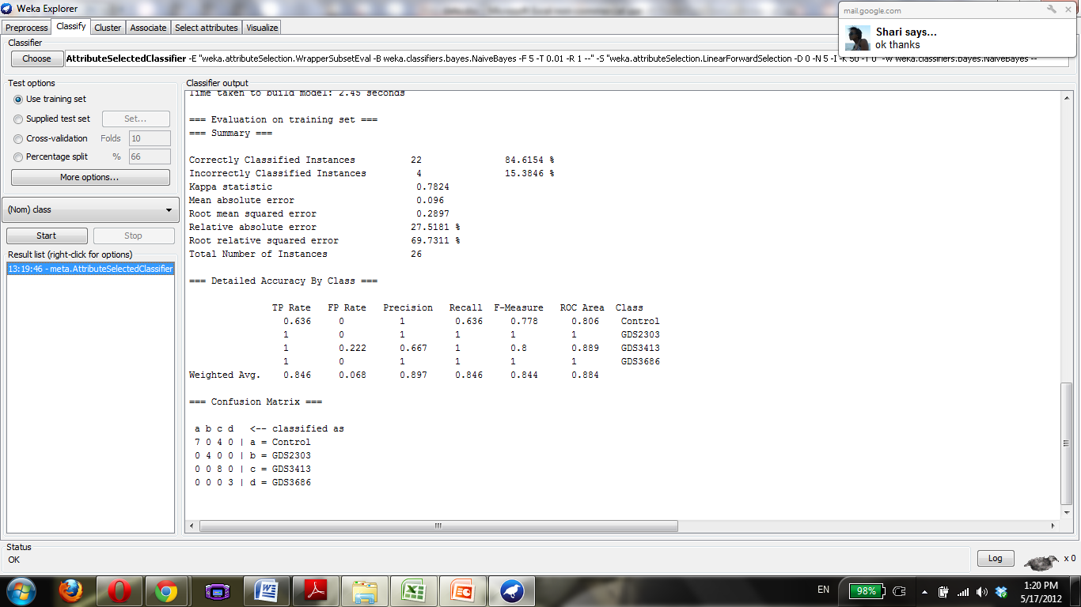

Slide 33
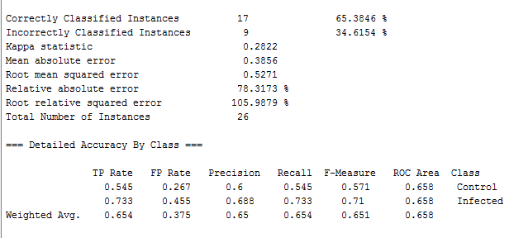
Atherosclerosis Singlenet

Slide 34
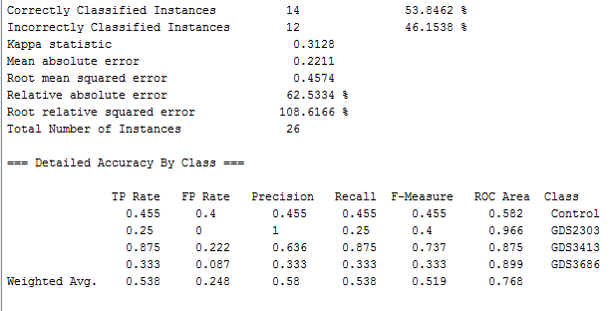
Atherosclerosis Multinet

Slide 35
Bipolar Disorder
Of 4 choose 3: GDS2190, GDS2191, GDS2779

Slide 36
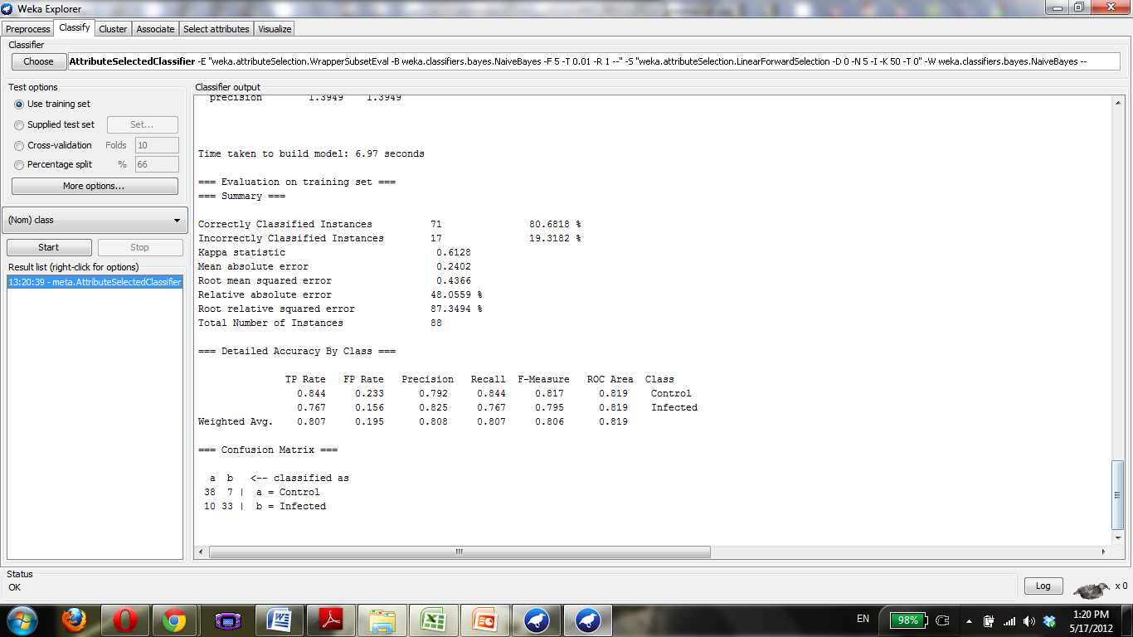

Slide 37
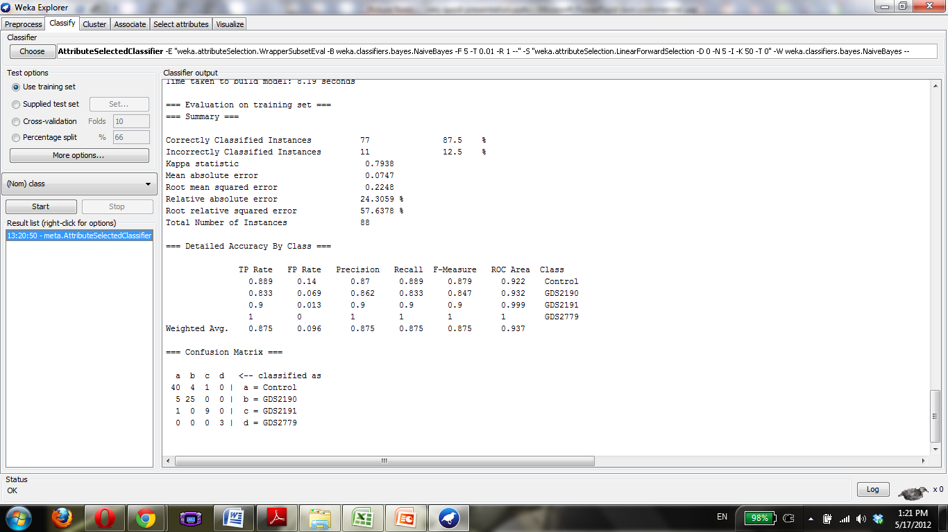

Slide 38
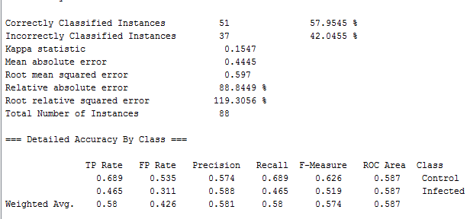
Bipolar Disorder Singlenet

Slide 39
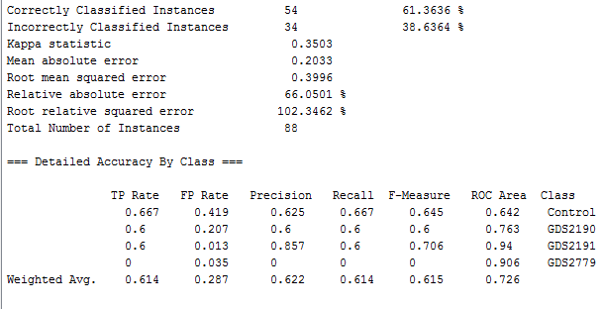
Bipolar Disorder Multinet

Slide 40
Breast Neoplasm
Of 90 choose:
GDS1250, GDS1326, GDS1329, GDS1363, GDS1477, GDS1549, GDS1627, GDS1664, GDS170, GDS1761, GDS1873, GDS1925, GDS2045, GDS2046, GDS2250, GDS2323, GDS2324, GDS2367, GDS2415, GDS2443, GDS2617, GDS2618, GDS2635, GDS2721, GDS2739, GDS2744, GDS2745, GDS2770, GDS2787, GDS2788, GDS2789, GDS2810, GDS2827, GDS2856, GDS2861, GDS3096, GDS3097, GDS3105, GDS3116, GDS3138, GDS3139, GDS3283, GDS3285, GDS3315, GDS3324, GDS3388, GDS3484, GDS3638, GDS3716, GDS806, GDS807, GDS817, GDS820, GDS823, GDS825, GDS845, GDS846, GDS847, GDS848, GDS88, GDS881, GDS892, GDS893, GDS992

Slide 41
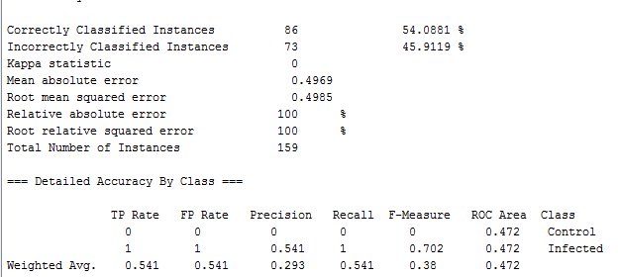
Breast Neoplasm Singlenet

Slide 42
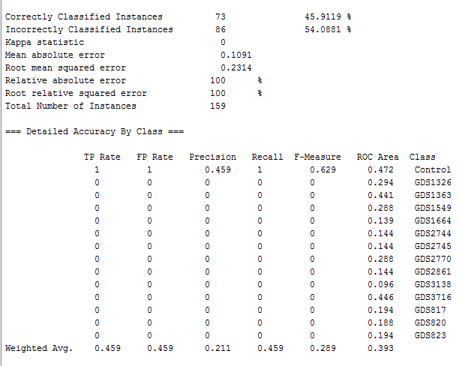
Breast Neoplasm Multinet

Slide 43
Bronchopulmonary Dysplasia
Of 2 choose 2: GDS3356, GDS2406

Slide 44
Carcinoma
130 to choose from: skip, will come back to later if time permits

Slide 45
Carcinoma, Squamous Cell
Of 18:
GDS2958, GDS2732, GDS2520, GDS2373, GDS2088, GDS2087, GDS2086, GDS1667, GDS1584, GDS1062

Slide 46


Slide 47
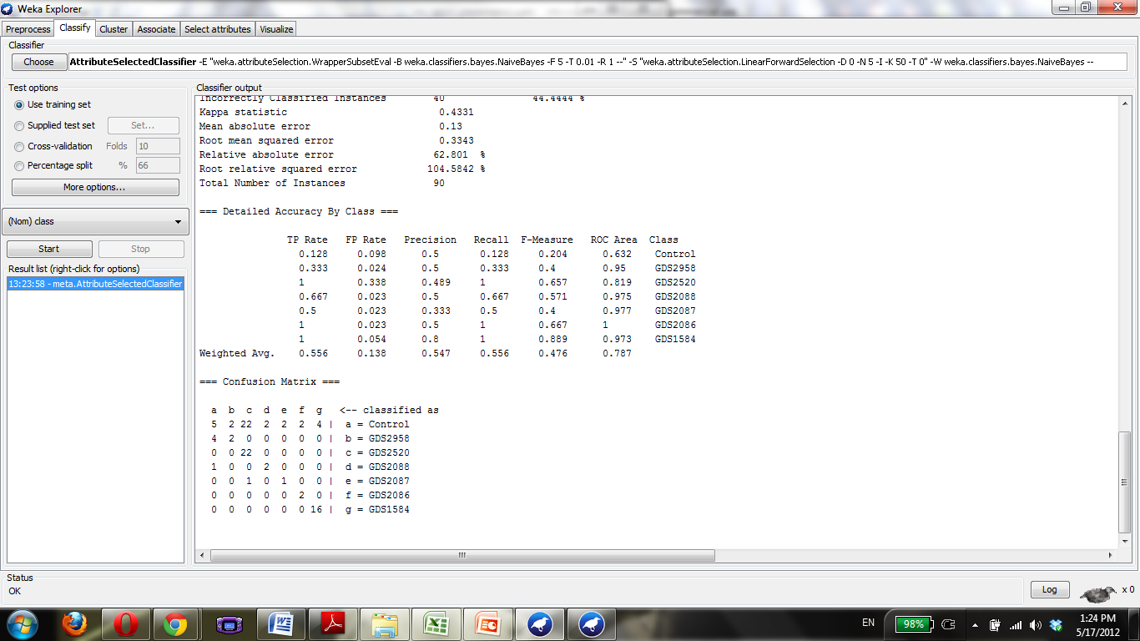

Slide 48
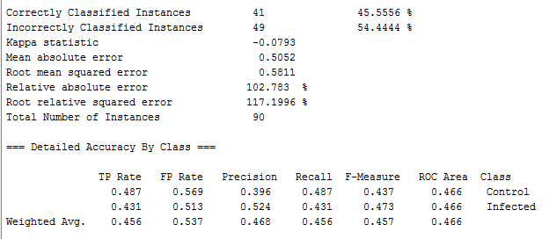
Carcinoma, Squamous Cell Singlenet

Slide 49
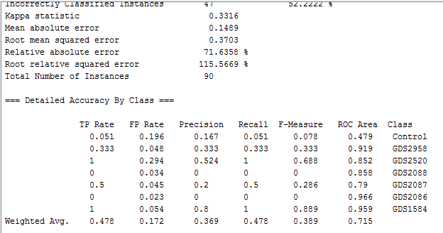
Carcinoma, Squamous Cell Multinet

Slide 50
Cardiomyopathy
Of 28, choose:
GDS3698, GDS3697, GDS3696, GDS3660, GDS3115, GDS3018, GDS2884, GDS2746, GDS2206, GDS2205, GDS651, GDS213

Slide 51
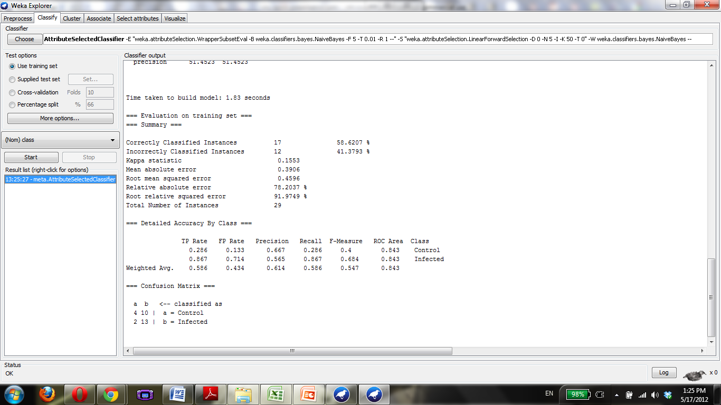

Slide 52
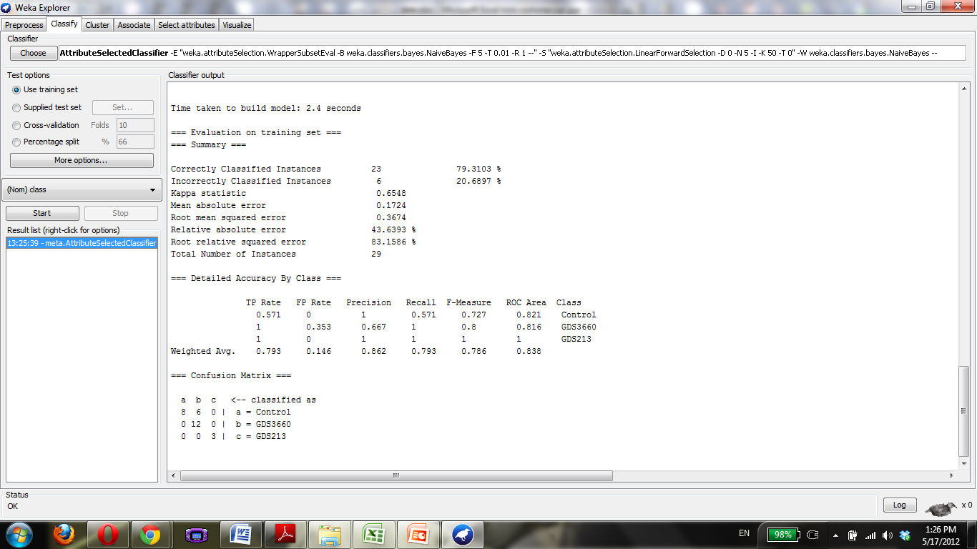

Slide 53
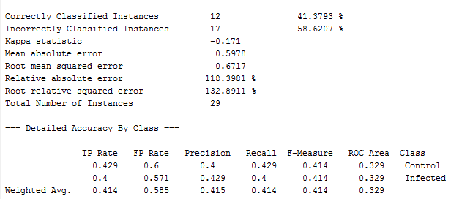
Cardiomyopathy Singlenet

Slide 54
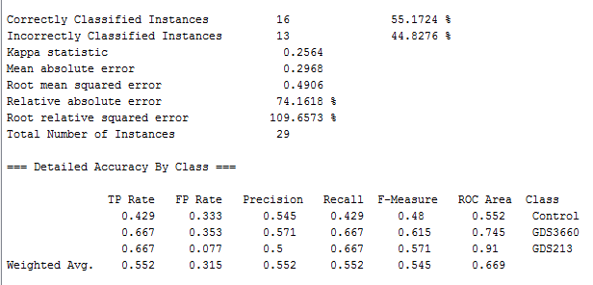
Cardiomyopathy Multinet

Slide 55
Colitis
Of 14, GDS3323, GDS3119, GDS2014, GDS1871, GDS1478

Slide 56
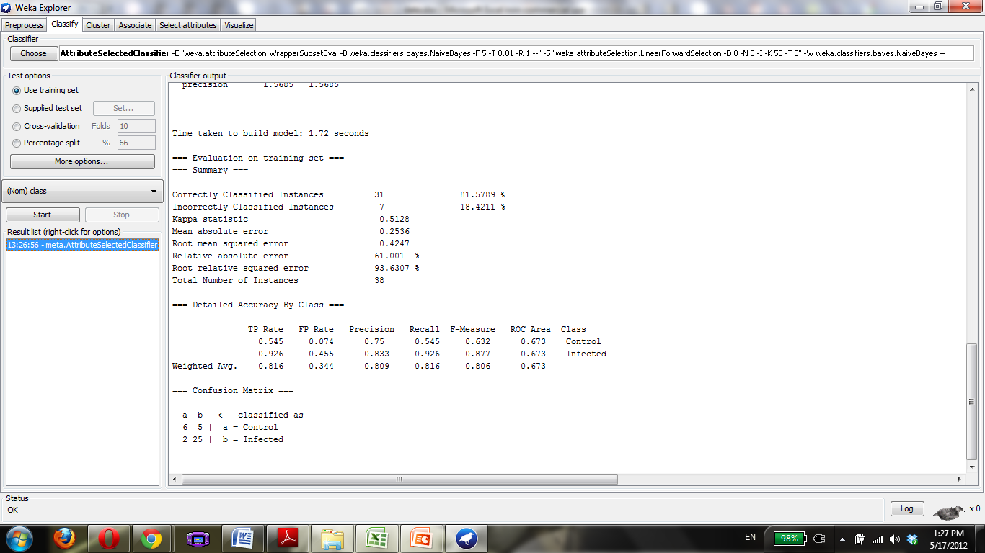

Slide 57
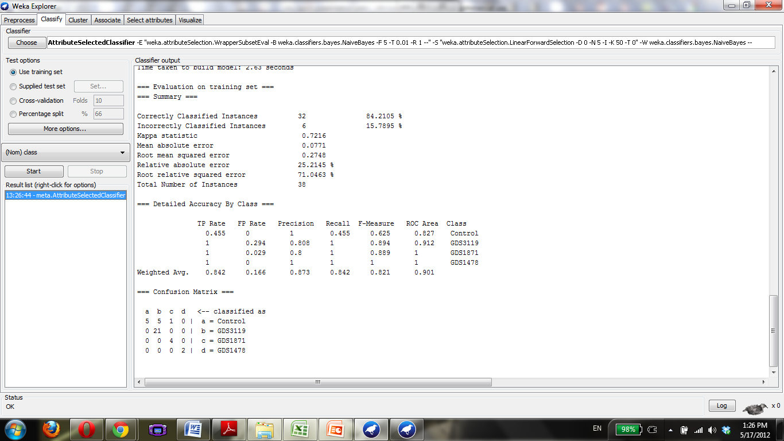

Slide 58
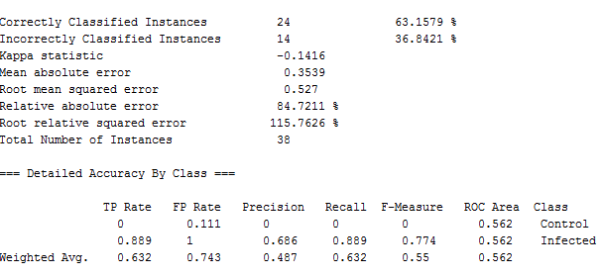
Colitis Singlenet

Slide 59
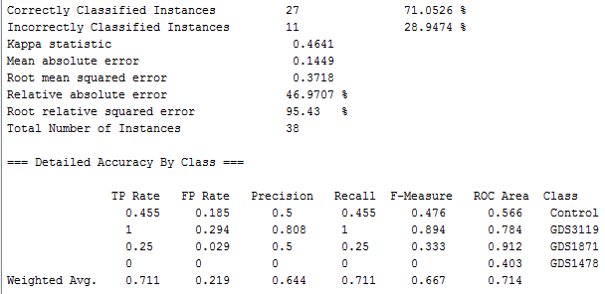
Colitis Multinet

Slide 60
Dermatitis
4
GDS2935, GDS2820, GDs2381, GDS2382,

Slide 61


Slide 62
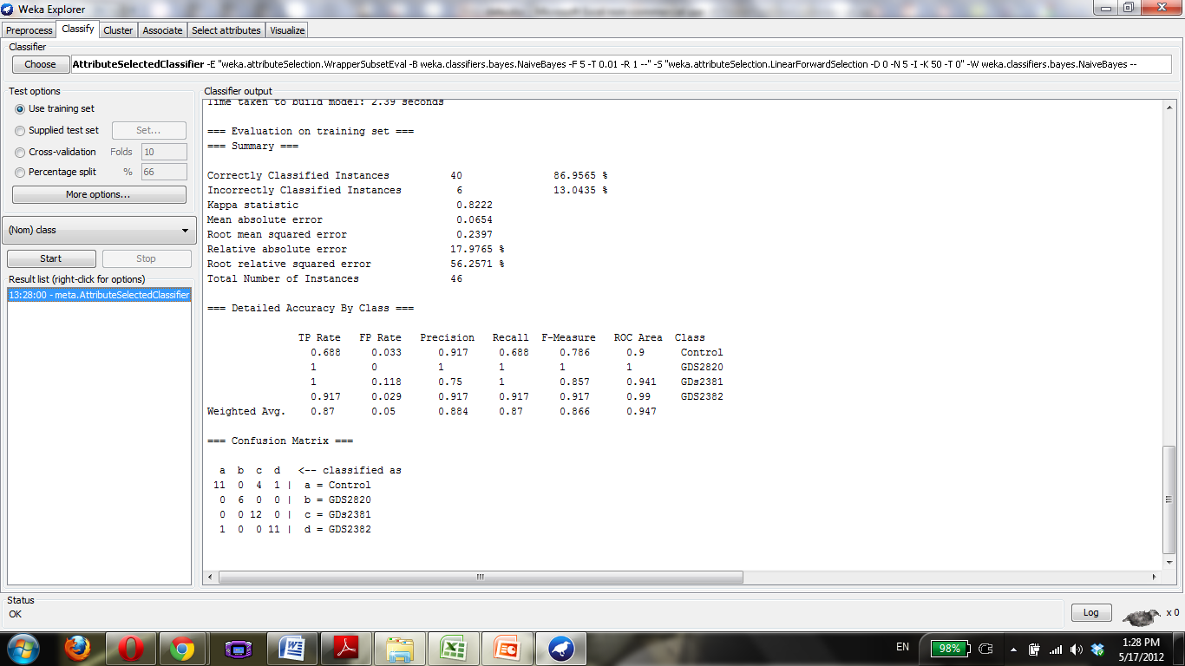

Slide 63
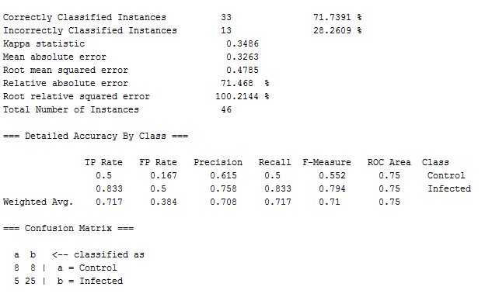
Dermatitis Singlenet

Slide 64
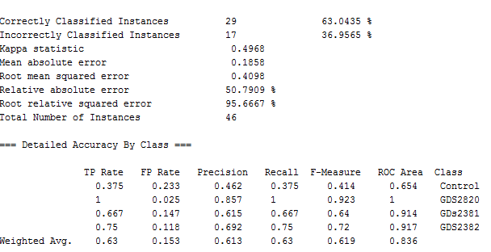
Dermatitis Multinet

Slide 65
Diabetes
Has 70 , come back to this later

Slide 66
Diabetes Mellitus
Has 70

Slide 67
Endometriosis
6 choose
GDS3092, GDS3060, GDS2835, GDS2737, GDS2052,

Slide 68


Slide 69
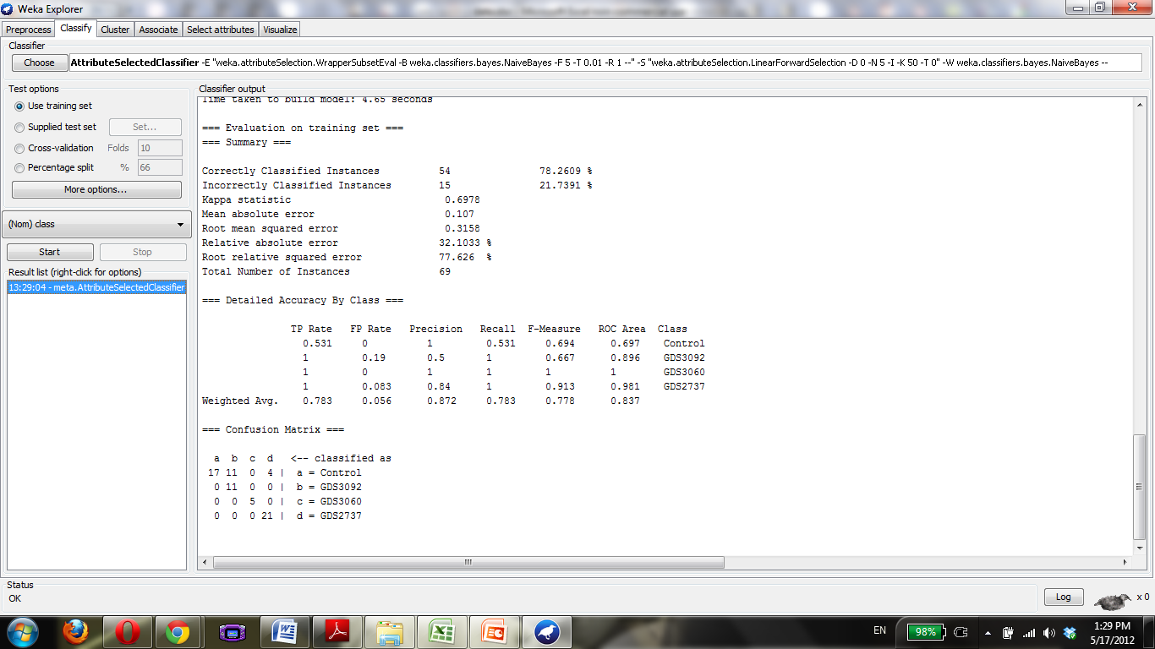

Slide 70
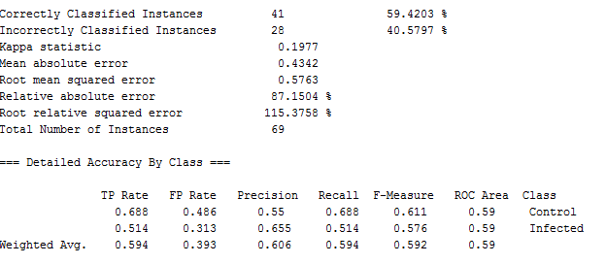
Endometriosis Singlenet

Slide 71
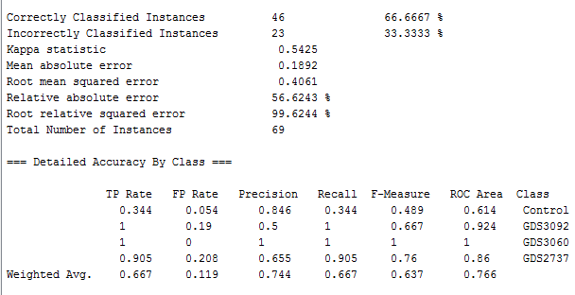
Endometriosis Multinet

Slide 72
Epilepsy
9,
GDS1745, GDS1626, GDS1051, GDS1050, GDS1018, GDS954

Slide 73
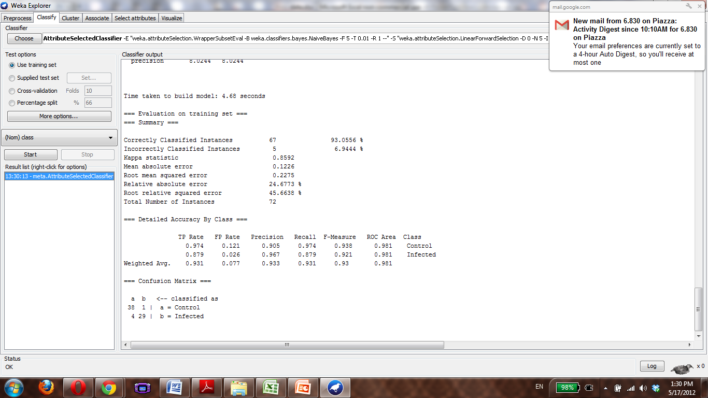

Slide 74
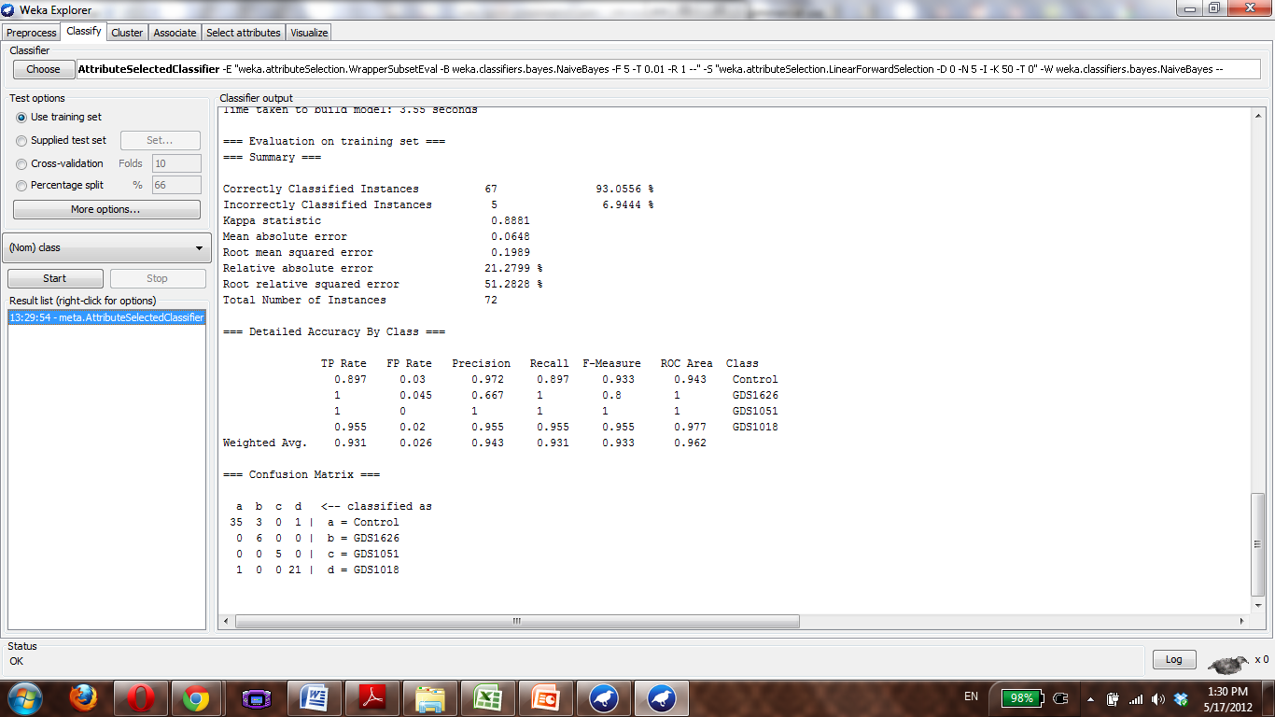

Slide 75
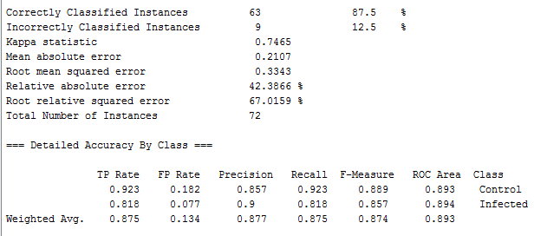
Epilepsy Singlenet

Slide 76
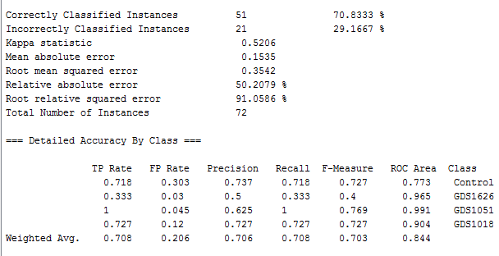
Epilepsy Multinet

Slide 77
Fibrosis
49
GDS1252, GDS1313, GDS1492, GDS1810, GDS1941, GDS2142, GDS2143, GDS2292, GDS2316, GDS2361, GDS2817, GDS2869, GDS2893, GDS3071, GDS3174, GDS3251, GDS3393, GDS3552, GDS387, GDS388, GDS493, GDS567, GDS588, GDS858

Slide 78
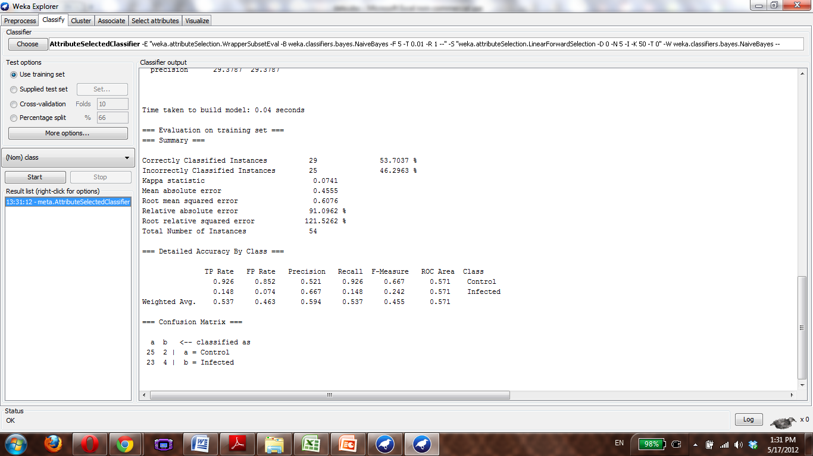

Slide 79
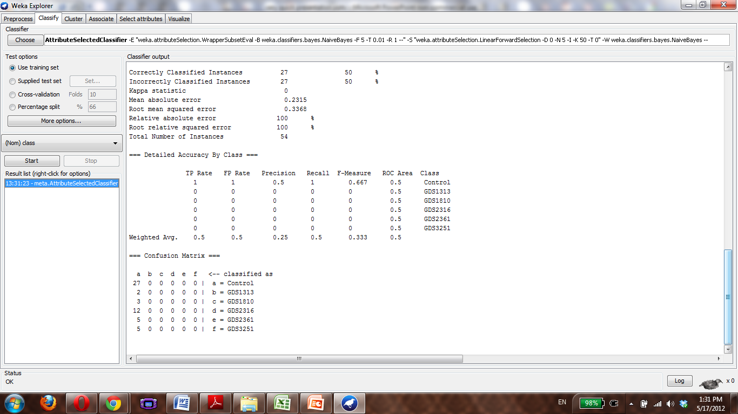

Slide 80

Fibrosis Singlenet

Slide 81

Fibrosis Multinet

Slide 82
Glaucoma
7
GDS2892, GDS1728, GDS1313, GDS1112, GDS359

Slide 83


Slide 84


Slide 85

Glaucoma Singlenet

Slide 86

Glaucoma Multinet

Slide 87
Heart Disease
14
GDS3663, GDS3659, GDS3623, GDS3600, GDS3594, GDS3573, GDS3513, GDS2316, GDS385, GDS384, GDS50, GDS49

Slide 88


Slide 89


Slide 90

Heart Disease Singlenet

Slide 91

Heart Disease Multinet

Slide 92
HIV
19
GDS3511, GDS2920, GDS2883, GDS2649, GDS2187, GDS2168, GDS2164, GDS1875, GDS1726, GDS1646, GDS1449, GDS1397, GDS1063, GDS708, GDS171

Slide 93


Slide 94


Slide 95

HIV singlenet

Slide 96

HIV Multinet

Slide 97
Huntington Disease
14
GDS3621, GDS3620, GDS3515, GDS3178, GDS2912, GDS2887, GDS1332, GDS1331

Slide 98


Slide 99


Slide 100

Huntington Disease Singlent

Slide 101

Huntington Disease Multinet

Slide 102
Hypertrophy
45
GDS3637, GDS3596, GDS3552, GDS3551, GDS3465, GDS3117, GDS3134, GDS3018, GDS2316, GDS2308, GDS2304, GDS2258, GDS2172, GDS2134, GDS1928, GDS1892, GDS1264, GDS1049, GDS902, GDS794, GDS742, GDS696, GDS654, GDS598, GDS446, GDS278, GDS252, GDS144, GDS61, GDS59

Slide 103


Slide 104


Slide 105

Hypertrophy Singlenet

Slide 106

Hypertrophy Multinet

Slide 107
Hypoxia
55
GDS3660, GDS3524, GDS3521, GDS3483, GDS3438, GDS3114, GDS3112, GDS2951, GDS2902, GDS2891, GDS2761, GDS2760, GDS2759, GDS2758, GDS2750, GDS2466, GDS2457, GDS2425, GDS2248, GDS2218, GDS2162, GDS2161, GDS2160, GDS2036, GDS2018, GDS1968, GDS1807, GDS1783, GDS1779, GDS1772, GDS1648, GDS1450, GDS1379, GDS1213, GDS1209, GDS710, GDS366, GDS272, GDS252, GDS246, GDS61, GDS59

Slide 108


Slide 109


Slide 110

Hypoxia Singlenet

Slide 111

Hypoxia Multinet

Slide 112
Inflammation
113

Slide 113
Ischemia
18
GDS3662, GDS3655, GDS2772, GDS2311, GDS2070, GDS1959, GDS1018, GDS1017, GDS808, GDS710

Slide 114


Slide 115


Slide 116

Ischemia Singlenet

Slide 117

Ischemia Multinet

Slide 118
Leiomyoma
6
GDS2246, GDS2245, GDS1476, GDS533, GDS484

Slide 119


Slide 120

Leiomyoma Singlenet

Slide 121

Leiomyoma Multinet

Slide 122
Leukemia
87

Slide 123
Lung Disease
27
GDS3705, GDS3496, GDS3483, GDS2604, GDS2486, GDS2372, GDS2188, GDS2143, GDS2142, GDS1941, GDS1673, GDS1436, GDS1304, GDS1255, GDS1252, GDS737, GDS534, GDS289, GDS251

Slide 124

Lung Disease Singlenet

Slide 125

Lung Disease Multinet

Slide 126
Lung Neoplasm
31
GDS3627, GDS3309, GDS3257, GDS3101, GDS3054, GDS2966, GDS2865, GDS2777, GDS2771, GDS2604, GDS2499, GDS2491, GDS2490, GDS2489, GDS2406, GDS2373, GDS2298, GDS2297, GDS1688, GDS1650, GDs1649, GDS1312, GDs1252, GDS1204, GDS737, GDS534
What the hell does down syndrome have to do w/ lung cancer?

Slide 127


Slide 128


Slide 129

Lung Neoplasm Singlenet

Slide 130

Lung Neoplasm Multinet

Slide 131
Lymphoma
35
GDS3516, GDS3291, GDS3147, GDS2988, GDS2908, GDS2554, GDS2295, GDS2042, GDS1960, GDS1839, GDS1807, GDS1750, GDS1617, GDS1419, GDS1409, GDS1063, GDS989, GDS988

Slide 132


Slide 133


Slide 134

Lymphoma Singlenet

Slide 135

Lymphoma Multinet

Slide 136
Malaria
12
GDS3591, GDS3284, GDS3145, GDS3118, GDS2822, GDS2524, GDS2362, GDS1563, GDS471

Slide 137


Slide 138

Malaria Singlenet

Slide 139

Malaria Multinet

Slide 140
Melanoma
23
GDS3517, GDS3489, GDS3012, GDS2735, GDS2244, GDS2200, GDS1989, GDS1965, GDS1964, GDS1440, GDS1375, GDS1314, GDS1078

Slide 141


Slide 142


Slide 143

Melanoma Singlenet

Slide 144

Melanoma Multinet

Slide 145
Mental Disorder
6
GDS3345, GDS2447, GDS2191, GDS2190,

Slide 146


Slide 147


Slide 148

Mental Disorder Singlenet

Slide 149

Mental Disorder Multinet

Slide 150
Muscular Dystrophy
40
GDS3579, GDS3475, GDS3474, GDS3398, GDS3209, GDS3027, GDS2996, GDS2884, GDS2746, GDS2192, GDs2158, GDS2056, GDS2055, GDS1778, GDS1334, GDS1333, GDS1233, GDS703, GDS639, GDS638, GDS614, GDS612, GDS611, GDS610, GDS609, GDS563, GDS270, GDS265, GDS264, GDS262, GDS236, GDS214

Slide 151

Muscular Dystrophy Singlenet

Slide 152

Muscular Dystrophy Multinet

Slide 153
Neoplasm
276

Slide 154
Neoplasm Metastasis
35
GDS3710, GDS3501, GDS3489, GDS3324, GDS3289, GDS3179, GDS3138, GDS3091, GDS2932, GDS2865, GDS2617, GDS2547, GDS2546, GDS2545, GDS2443, GDS1780, GDS1210, GDS1062, GDS756, GDS274, GDS232

Slide 155


Slide 156


Slide 157

Neoplasm Metastasis Singlenet

Slide 158

Neoplasm Metastasis Multinet

Slide 159
Neurodegenerative Disease
22
GDS3545, GDS3544, GDS3408, GDS2919, GDS2887, GDS2765, GDS2176, GDS2175, GDS1756, GDS1488

Slide 160


Slide 161


Slide 162

Neurodegenerative Disease Singlenet

Slide 163

Neurodegenerative Disease Multinet

Slide 164
Obesity
69

Slide 165
Parkinson Disease
10
GDS3129, GDS3128, GDS2821, GDS2519, GDS2053, GDS2027, GDS1641, GDS956

Slide 166


Slide 167


Slide 168

Parkinson Disease Singlenet

Slide 169

Parkinson Disease Multinet

Slide 170
Polycystic Ovary Syndrome
4
GDS3104, GDS2084, GDS1051, GDS1050

Slide 171


Slide 172


Slide 173

Polycystic Ovary Syndrome Singlenet

Slide 174

Polycystic Ovary Syndrome Multinet

Slide 175
Pre-Eclampsia
3
GDS3467, GDS2548, GDS2080

Slide 176


Slide 177


Slide 178

Pre-Eclampsia Singlenet

Slide 179

Pre-Eclampsia Multinet

Slide 180
Progeria
3
GDS3495, GDS1504, GDS1503

Slide 181


Slide 182


Slide 183

Progeria Singlenet

Slide 184

Progeria Multinet

Slide 185
Psoriasis
6
GDS3539, GDS2611, GDS2518

Slide 186


Slide 187


Slide 188


Slide 189


Slide 190
Pulmonary Disease
27
GDS3705, GDS3483, GDS3356, GDS2866, GDS2143, GDS2142, GDS1673, GDS1436, GDS1304, GDS1252, GDS737, GDS534, GDS289, GDS251, GDS240

Slide 191


Slide 192


Slide 193


Slide 194


Slide 196
Preliminary Conclusions
Singlenet vs. Multinet:
Neither seems to have much of an advantage over the other.
However
You either have a significantly insignificant difference, or a dramatic difference between the ROCs
Why?
Interesting. Examine further, collect statistics on Multinet vs. Singlenet ROC differences?

Slide 197
Next Steps
Examine further, collect statistics on Multinet vs. Singlenet ROC differences?
Also examine of # of GEO datasets affects this difference

Slide 198
And more…
Running through the diseases in the file

